Slide 1

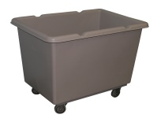
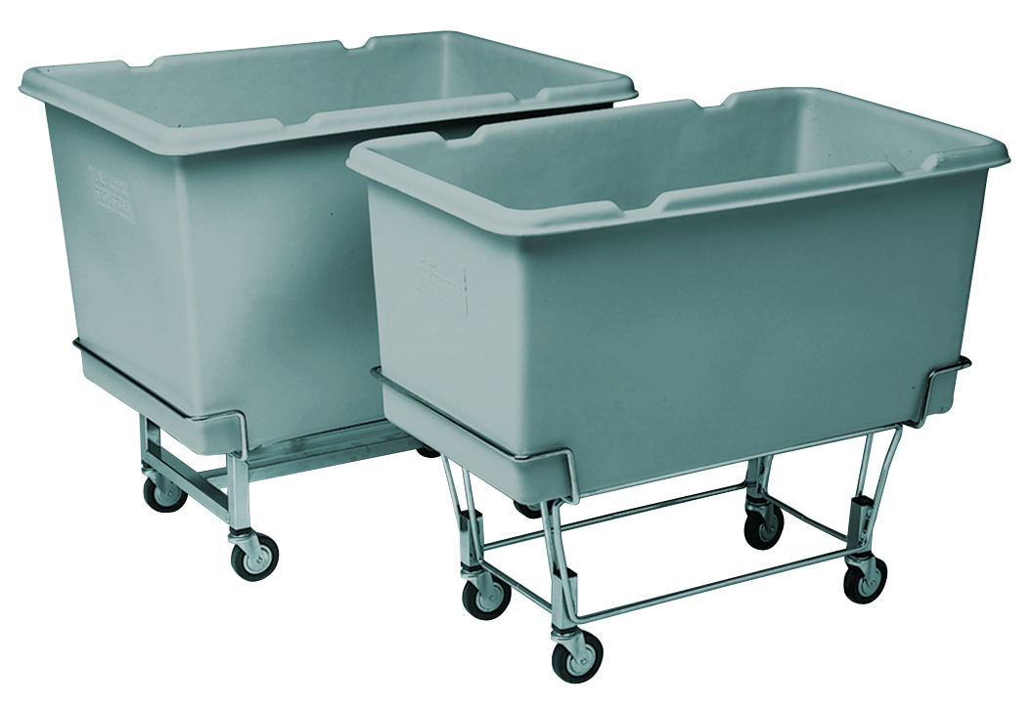
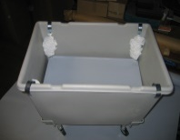
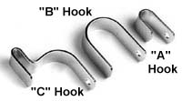
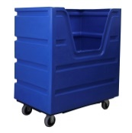
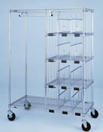
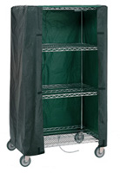
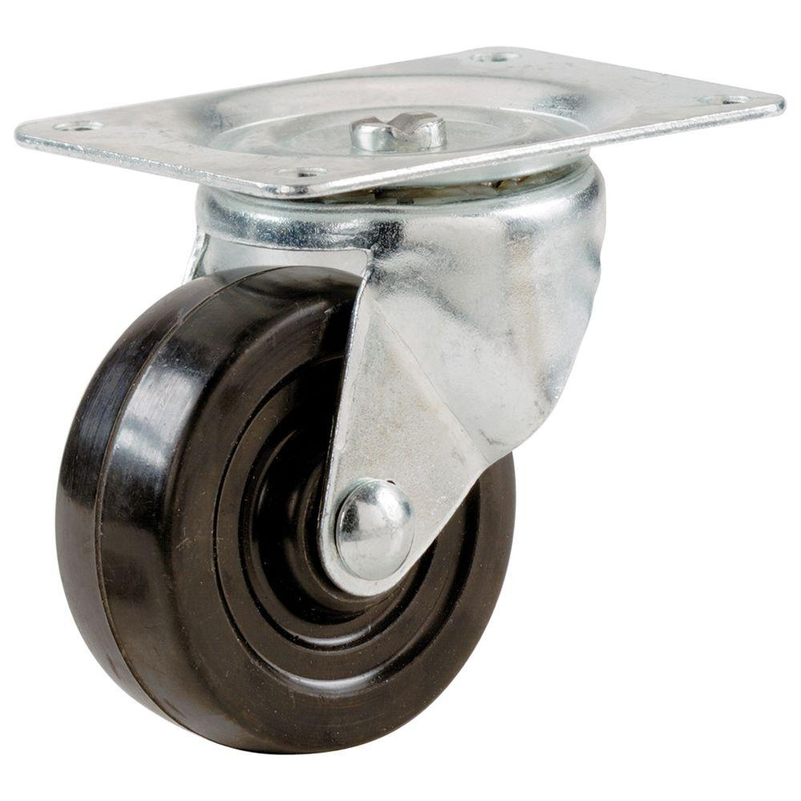
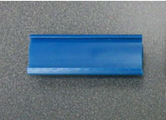

ADDITIONAL CARTS & ACCESSORIES
PRODUCT IMAGE | PRODUCT NAME | PRODUCT DESCRIPTION
 | Poly Cart | Sizes ranging from 4 bushel to 48 bushel Some sizes feature “easy access” cutout Available: backsaver, nylon cart cover, and nylon liner for every size
 | Elevated & Weigh Scale Poly Carts | Sizes available – 4 bushel and 6 bushel Available: Backsaver
 | Backsaver Platform | As you fill your cart and empty it, the Backsaver lowers and rises, always keeping your material at the top Sizes for every cart Washable spring covers
 | Bulk Laundry Truck | 2 sizes - 37 cu. ft. and 45 cu. ft. 1000 lb. max load Available: Backsaver and nylon cart cover
 | Personal Clothing Cart | Can ship partially assembled to reduce freight costs. Customizable configuration (size, number of compartments and hanging bars)
 | Nylon Cart Cover | Many color options Customizable with zippers, ties, velcro etc.
 | Other accessories | Replacement wheels Label holders Hangers Bagels for personal clothing carts

